Slide 1

6th Grade Accelerated Math
Unit 8, Lesson 1 Volume of Right Rectangular Prisms Volume 2, pg. 3

Slide 2


Benchmark
MA.6.GR.2.3
Solve mathematical and real-world problems involving the volume of right rectangular prisms with positive rational number edge lengths using a visual model and a formula.
volume 2, pg. 3

Slide 3
Integrated Mathematical Thinking and Reasoning Standards
MA.K12.MTR.1.1 Actively participate in effortful learning both individually and collectively.
MA.K12.MTR.2.1 Demonstrate understanding by representing problems in multiple ways.
MA.K12.MTR.4.1 Engage in discussions that reflect on the mathematical thinking of self and others.
MA.K12.MTR.5.1 Use patterns and structure to help understand and connect mathematical concepts.
volume 2, pg. 3

Slide 4

Learning Target
I can pack a rectangular prism using a cube with fractional edges.
volume 2, pg. 3

Slide 5

Warm-Up
volume 2, pg. 3

Slide 6
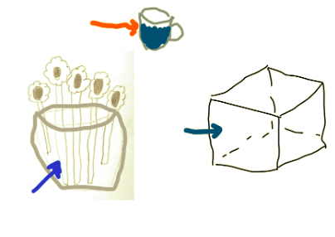
8.1.1 Warm-Up: Guess the Word
Micah and his family are playing a game in which each person chooses a card with a word written on it. Once a person chooses, they have one minute to draw a picture of the word. Then, his team guesses the word.
Micah chose the word “volume”. His drawing is shown.
volume 2, pg. 3

Slide 7
Choose the statement(s) that best describe volume. Select all that apply.
the sum of the length of all the edges of a three-dimensional object
the distance around a two-dimensional shape
the amount of three-dimensional space enclosed within a container
the total area of the surface of a three-dimensional object
the formula length times width times height
volume 2, pg. 3

Slide 8

Exploration
volume 2, pg. 4

Slide 9

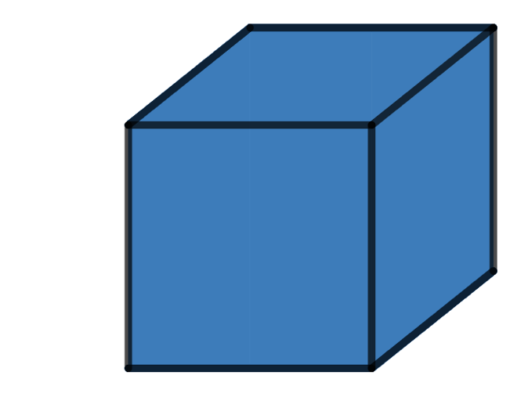




8.1.2 Exploration: The Unit Cube
Two images of the same cube are shown. The image on the right shows the coordinates of some of the edges of the cube.
$$(0, 1)$$
$$(−1, 0)$$
$$(−0.5, 0)$$
$$(0, 0)$$
volume 2, pg. 4

Slide 10
Share three things you know, two things you are not sure of, and one thing you have a question about.
I Know… | I’m Not Sure Of… | A Question I Have…
volume 2, pg. 4

Slide 11

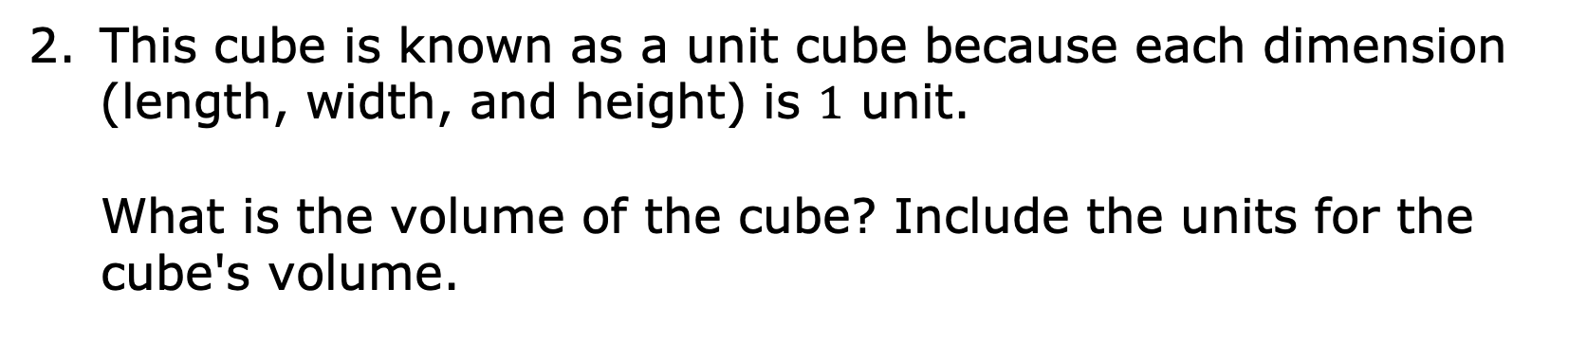
This cube is known as a unit cube because each dimension (length, width, and height) is $1$ unit.
What is the volume of the cube? Include the units for the cube's volume.
A cube is a rectangular prism with six congruent square faces.
volume 2, pg. 4

Slide 12
Exploration
volume 2, pg. 5

Slide 13
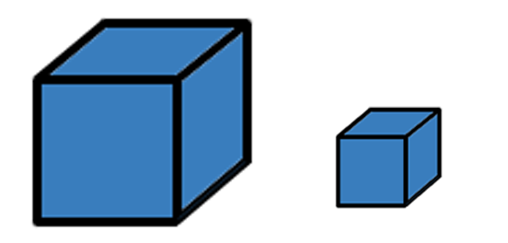
8.1.3 Exploration: Drawing Fractional Cubes
Two cubes are shown.
The cube on the left is a unit cube. The cube on the right has different dimensions.
volume 2, pg. 5

Slide 14
Share an observation and something you wonder about this new cube.
Observation | Wondering
volume 2, pg. 5

Slide 15
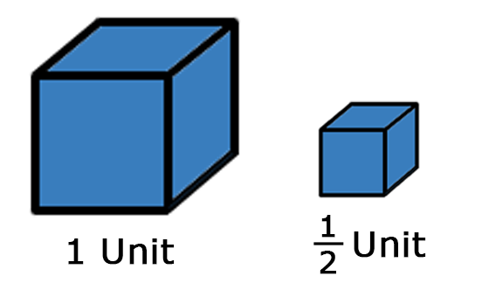

A unit cube and a half-unit cube are shown.
Make a guess of how many cubes with a length of $\frac{1}{2}$ unit, width of $\frac{1}{2}$ ​unit, and height of $\frac{1}{2}$ unit will fit in the $1$-unit cube.
volume 2, pg. 5

Slide 16
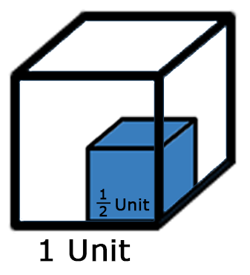
The figure shows a half-unit cube inside a unit cube.
Explain how the figure helps you to visualize how to pack cubes that have a fractional length.
volume 2, pg. 5

Slide 17
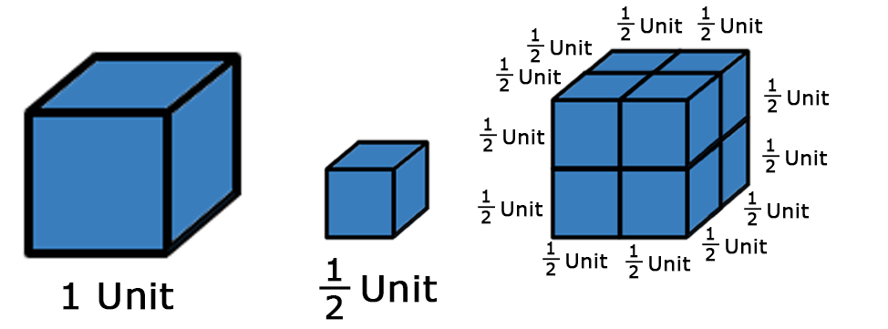
Three figures are shown.
Explain how the figures help you visualize how to pack cubes that have a fractional length.
volume 2, pg. 6

Slide 18
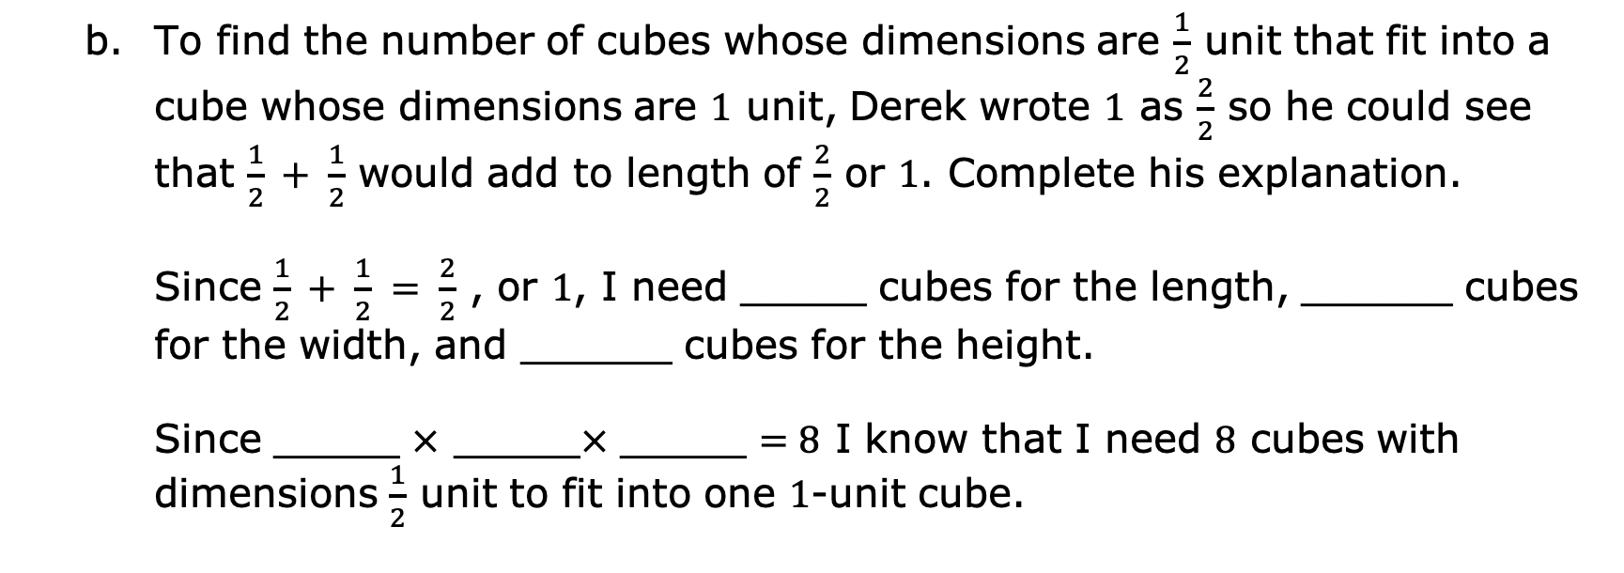
To find the number of cubes whose dimensions are $\frac{1}{2}$ unit that fit into a cube whose dimensions are $1$ unit, Derek wrote $1$ as $\frac{2}{2}$ so he could see that $\frac{1}{2} + \frac{1}{2}$ would add to length of $\frac{2}{2}$ or $1$. Complete his explanation.
Since $\frac{1}{2} + \frac{1}{2} = \frac{2}{2}$ , or $1$, I need _____ cubes for the length, ______ cubes for the width, and ______ cubes for the height.
Since _____ $×$ _____$×$ _____ $=8$ I know that I need $8$ cubes with dimensions $\frac{1}{2}$ unit to fit into one $1$-unit cube.
volume 2, pg. 6

Slide 19

Guided Instruction
volume 2, pg. 6

Slide 20
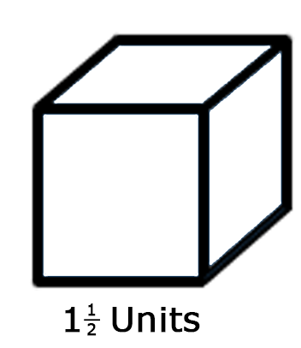
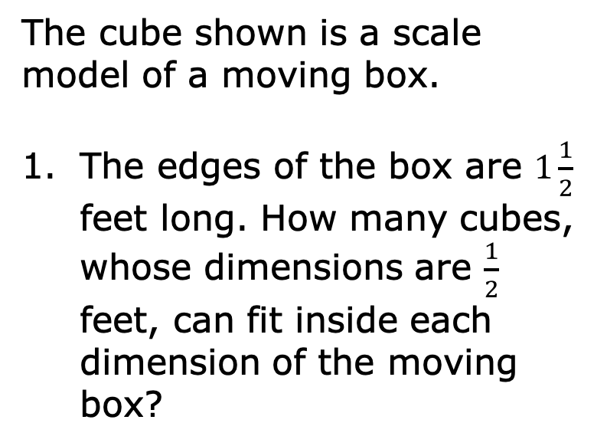
8.1.4 Guided Instruction: Volume with Fractional Cubes
The cube shown is a scale model of a moving box.
The edges of the box are $1\frac{1}{2}$ feet long. How many cubes, whose dimensions are $\frac{1}{2}$ feet, can fit inside each dimension of the moving box?
volume 2, pg. 6

Slide 21
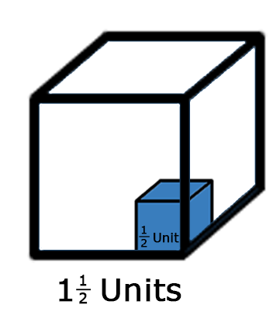
Sketch the cubes that can fit inside each dimension of the moving box.
volume 2, pg. 6

Slide 22
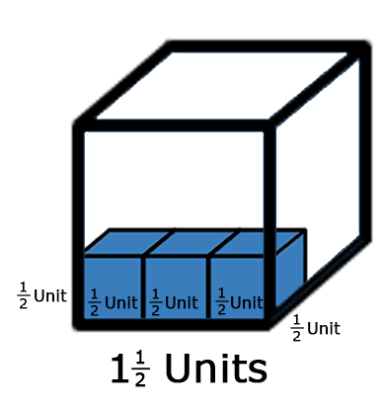
Since $3$ cubes, whose dimensions are $\frac{1}{2}$ unit, will fit inside each dimension, how many of these cubes would be needed to pack the moving box?
volume 2, pg. 7

Slide 23
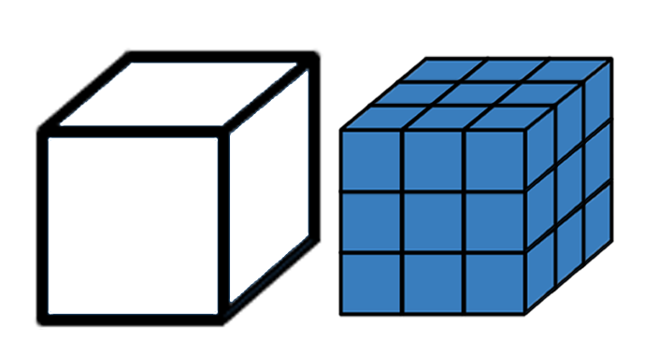

This cube is a scale model of a moving box. The edges of the box are $1\frac{1}{2}$ feet long.
Since there are $27$ cubes whose dimensions are $\frac{1}{2}$ feet that will fill the moving box, the volume of the moving box can be found by multiplying the volume of the fractional cube by $27$. What is the volume of a cube whose dimensions are $\frac{1}{2}$ feet?
volume 2, pg. 7

Slide 24
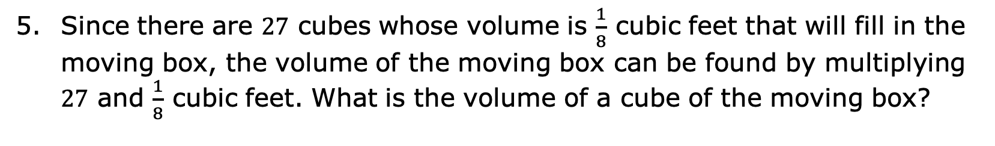
Since there are $27$ cubes whose volume is $\frac{1}{8}$ cubic feet that will fill in the moving box, the volume of the moving box can be found by multiplying $27$ and $\frac{1}{8}$ cubic feet. What is the volume of a cube of the moving box?
volume 2, pg. 7

Slide 25
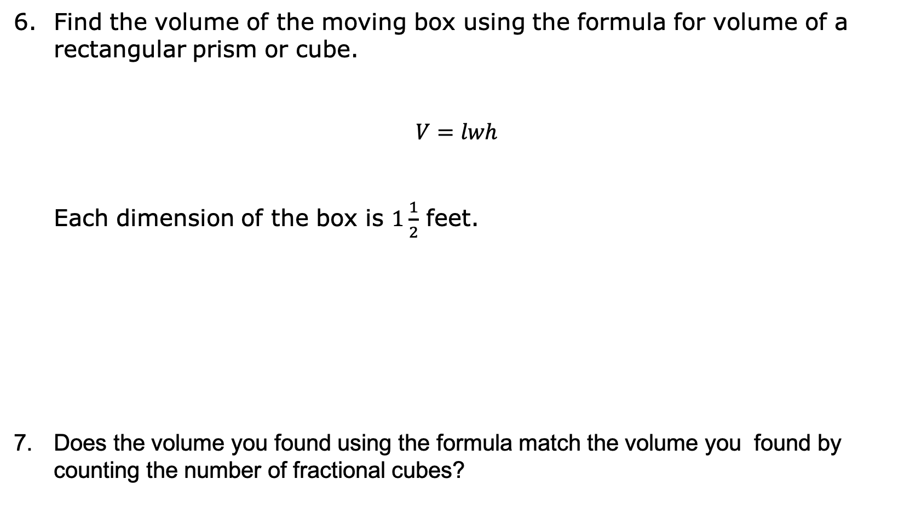
Find the volume of the moving box using the formula for volume of a rectangular prism or cube.
$$V=lwh$$
Each dimension of the box is $1\frac{1}{2}$ feet.
Does the volume you found using the formula match the volume you found by counting the number of fractional cubes?
volume 2, pg. 7

Slide 26
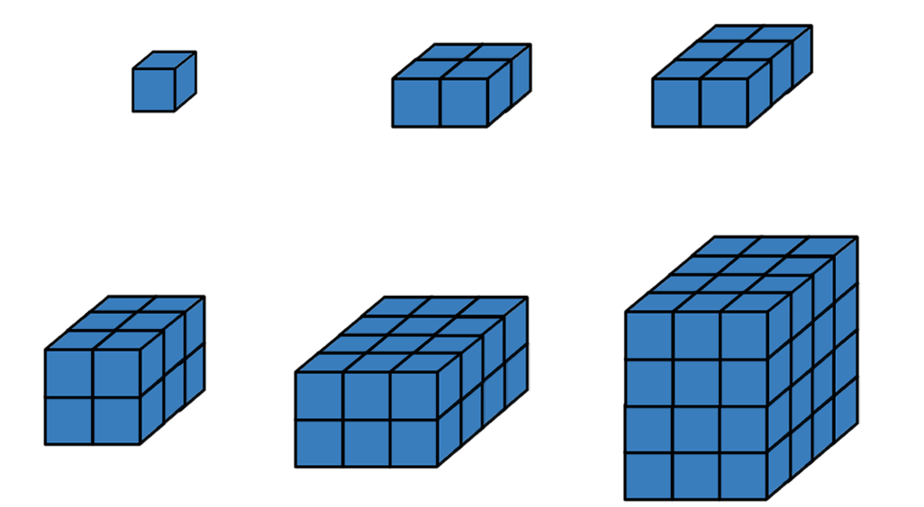
The images show different rectangular prisms composed of various numbers of cubes.
What do you notice?
Explain how the dimensions of the prism can be determined using the cubes shown if each small blue cube is 1 unit cube.
volume 2, pg. 8

Slide 27
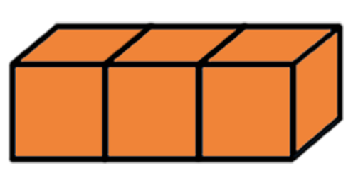
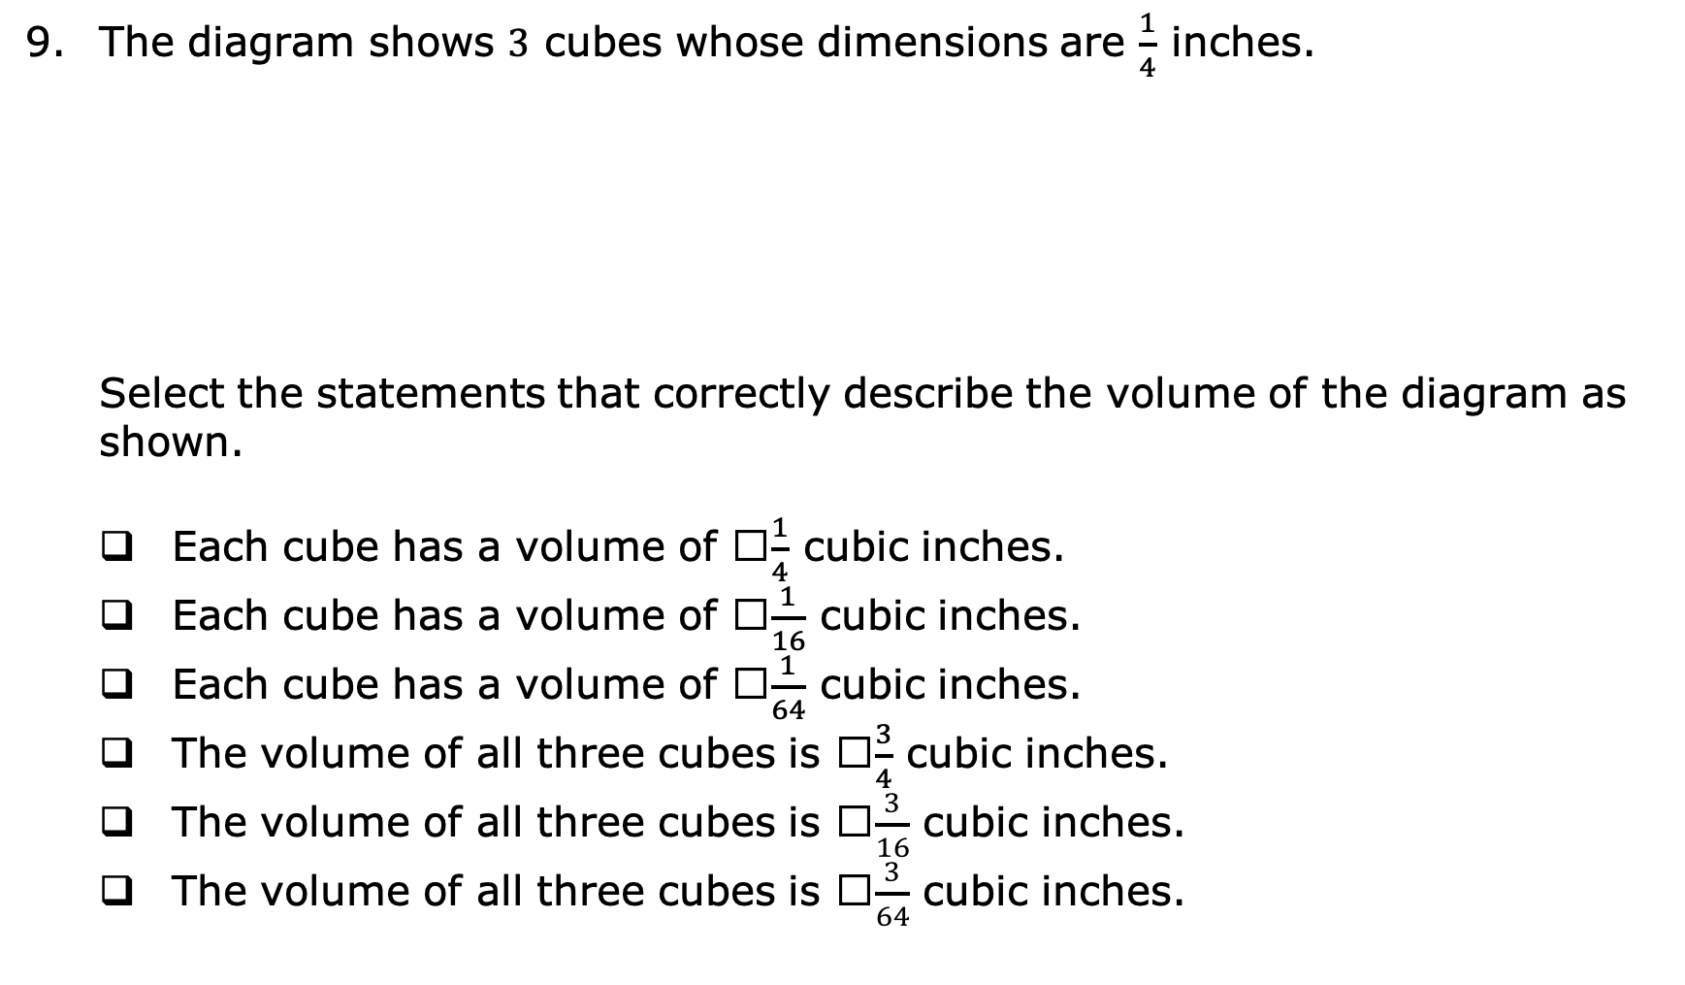
The diagram shows $3$ cubes whose dimensions are $\frac{1}{4}$ inches.
Select the statements that correctly describe the volume of the diagram as shown.
Each cube has a volume of ​$\frac{1}{4}$ cubic inches.
Each cube has a volume of ​$\frac{1}{16}$ cubic inches.
Each cube has a volume of ​$\frac{1}{64}$ cubic inches.
The volume of all three cubes is ​$\frac{3}{4}$ cubic inches.
The volume of all three cubes is ​$\frac{3}{16}$ cubic inches.
The volume of all three cubes is ​$\frac{3}{64}$ cubic inches.
volume 2, pg. 8

Slide 28
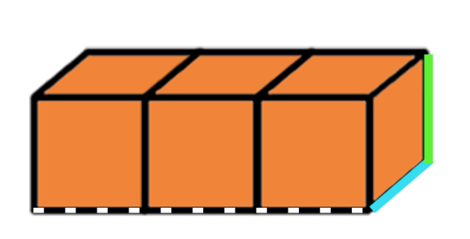

The same diagram of $3$ cubes whose dimensions are $\frac{1}{4}$ inches is shown.
The dotted line represents the total length of the $3$cubes. How long, in inches, is the dotted line?
$\frac{4}{4}$ inches
$\frac{1}{4}$ inches
$\frac{3}{4}$ inches
$\frac{2}{4}$ inches
volume 2, pg. 8

Slide 29

The same diagram of $3$ cubes whose dimensions are $\frac{1}{4}$ inches is shown.
The blue line represents the width of the $3$ cubes.
What is the width, in inches?
$\frac{1}{4}$ inches
$\frac{2}{4}$ inches
$\frac{3}{4}$ inches
$\frac{4}{4}$ inches
volume 2, pg. 9

Slide 30

The same diagram of $3$ cubes whose dimensions are $\frac{1}{4}$ inches is shown.
The green line represents the height of the cubes.
What is the height, in inches?
$\frac{1}{4}$ inches
$\frac{2}{4}$ inches
$\frac{3}{4}$ inches
$\frac{4}{4}$ inches
volume 2, pg. 9

Slide 31

The same diagram of $3$ cubes whose dimensions are $\frac{1}{4}$ inches is shown.
Use the dimensions you found to determine the volume of all three cubes with the formula, $V=lwh$.
volume 2, pg. 9

Slide 32
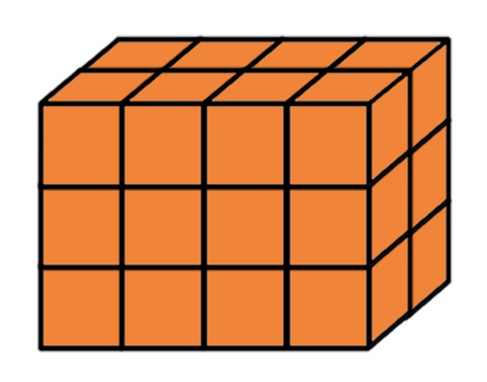

Finding volume using fractional unit cubes can be done by first finding the volume of one of the fractional unit cubes, and then multiplying that by the total number of fractional unit cubes.
A rectangular prism is shown.
How many unit cubes whose dimensions are $\frac{1}{4}$ inch fill up the rectangular prism?
volume 2, pg. 9

Slide 33


Each unit cube whose dimensions are $\frac{1}{4}$ ​inch has a volume of $\frac{1}{64}$ ​cubic inches.
Find the total volume, in cubic inches, represented in the diagram by multiplying the number of cubes that fill the rectangular prism by the volume of one of the cubes
volume 2, pg. 9

Slide 34
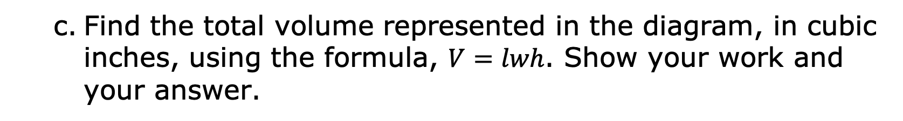
Find the total volume represented in the diagram, in cubic inches, using the formula, $V=lwh$. Show your work and your answer.
volume 2, pg. 9

Slide 35

Your Turn
volume 2, pg. 10

Slide 36
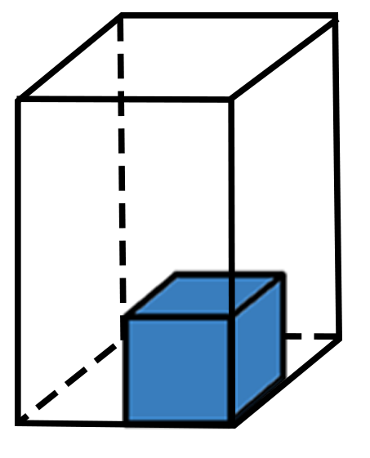
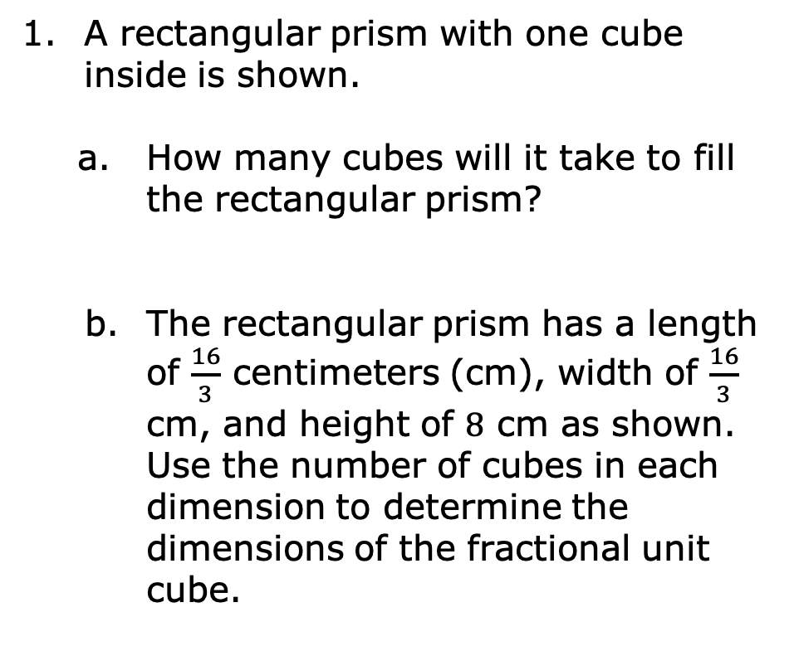
8.1.5 Your Turn!
A rectangular prism with one cube inside is shown.
How many cubes will it take to fill the rectangular prism?
The rectangular prism has a length of $\frac{16}{3}$ centimeters (cm), width of $\frac{16}{3}$ cm, and height of $8$ cm as shown.
Use the number of cubes in each dimension to determine the dimensions of the fractional unit cube.
volume 2, pg. 10

Slide 37
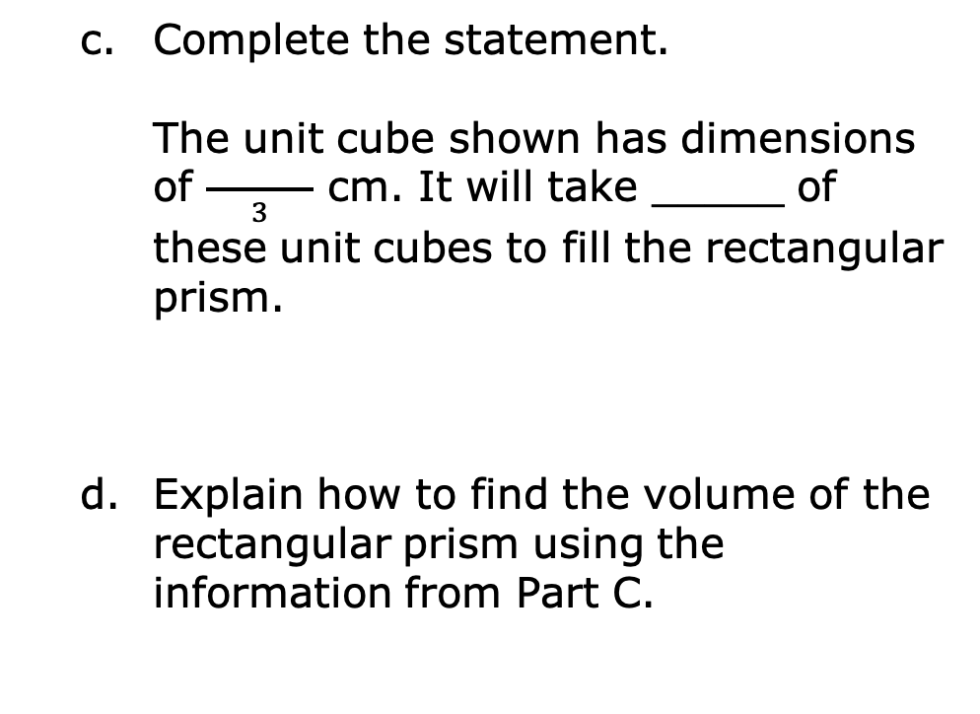
Complete the statement.
The unit cube shown has dimensions of $\frac{ }{3}$ cm. It will take _____ of these unit cubes to fill the rectangular prism.
Explain how to find the volume of the rectangular prism using the information from Part C.
volume 2, pg. 10

Slide 38

Wrap-Up
volume 2, pg. 10

Slide 39
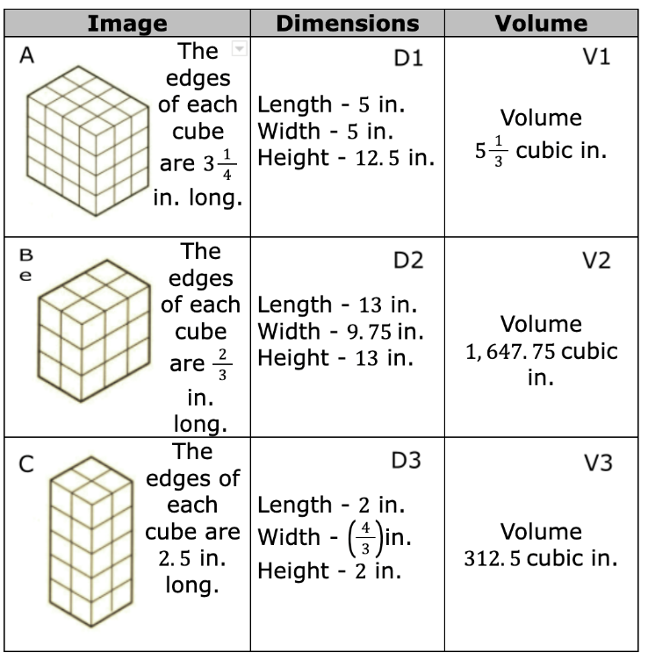
8.1.6 Wrap-Up: Ticket Out the Door
Match each image with its corresponding dimensions and volume. Use the table below to record your answers.
Image | Dimensions | Volume
A
B
C
volume 2, pg. 10

